Slide 1
Clinical Practice Highlights For Cutaneous MELANOMA ESMO 2025
Hazem ksiri ,MD
04-05/12/2025

Slide 2
Introduction
Melanoma is a tumor of melanocytes
The median age at diagnosis is 59 years.
Melanoma constitutes 5.5% of all cancers.
About 100,640 new melanomas will be diagnosed (about 59,170 in men and 41,470 in women).
About 8,290 people are expected to die of melanoma (about 5,430 men and 2,860 women).
However, these figures for new cases may represent a substantial underestimate, as many superficial and in situ melanomas treated in the outpatient setting are not reported.
Melanoma death rates declined rapidly from 2013 to 2017, largely because of advances in treatment. Rates fell by about 6% to 7% per year.

Slide 3
Introduction
the highest incidence rates observed in Western and northern countries (Europe, America , Australia)
Melanoma is rare in most African and Asian countries ⁽¹⁾
UV irradiation has been identified as a major carcinogen involved in melanomagenesis.
UV irradiation is associated with a distinct DNA damage signature and a high rate of mutations per megabase.
In a randomised trial, prevention of UV exposure, including the regular use of sunscreen, has been shown to diminish the incidence of primary cutaneous melanomas in an Australian population. ⁽³⁾
The Cancer Genome Atlas (TCGA) melanoma programme, a UV signature (i.e. high fraction of C>T transitions at dyprimidines) was identified in >75% of melanoma samples profiled.
among all cancer types profiled by the TCGA, melanoma was associated with the highest tumor (somatic) mutation burden overall. ⁽²⁾

Slide 4
Overview
Most melanomas are cutaneous, but can also be mucosal (~1.4%) or ocular (3–5%) in origin.
Among ocular melanomas, 83% arise from uvea, 5% from conjunctiva, and 10% from other sites. The most common site for uveal melanoma is the choroid
Mucosal melanoma is a rare and aggressive subtype of melanoma that is associated with a particularly poor prognosis.
Its genetic profile differs from that of ultraviolet (UV)-induced melanomas, with a lower mutational burden and more structural variants.
Compared with cutaneous melanoma, mucosal melanoma is associated with a lower frequency of BRAF (0%-21% versus 42%-50%) and RAS mutations (5%-25% versus 30%) but a higher frequency of KIT mutations (10%-15% versus 5%-10%).

Slide 5
Overview
Melanoma is an immunogenic tumor
targeting immunological pathways for the development of efficacious treatments is essential
For many decades, the most common treatment regimens for metastatic melanoma were the systemic immuno-stimulating cytokines such as interleukin-2 (IL-2) and interferon-alpha (IFN-α)
With the use of immune checkpoint inhibitors, immunotherapy for melanoma has substantially improved.
Ipilimumab, the first fully humanized immunoglobulin (Ig) G1 monoclonal antibody, was approved for metastatic melanoma (2011). Ipilimumab blocks the cytotoxic T-lymphocyte antigen (CTLA)-4 to produce anticancer effects.

Slide 6
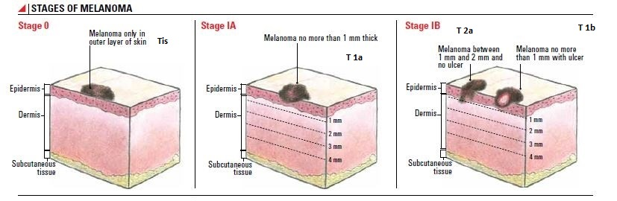
Staging System

Slide 7
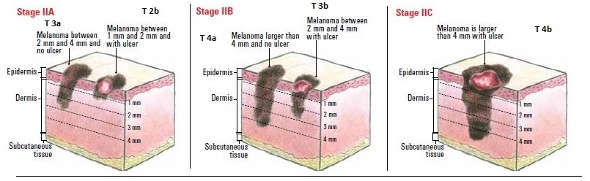
Staging System

Slide 8
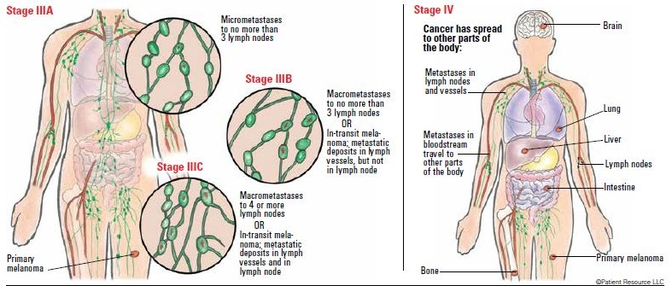
Staging System

Slide 9
STAGING AND RISK ASSESSMENT
Physical examination (Dermoscopy) with special attention to any suspicious pigmented lesions, tumour satellites, in-transit metastases (ITMs) and regional lymph nodes (LNs) is mandatory.
In low-risk primary cutaneous melanomas (pT1a), no additional investigations are necessary.
In higher tumour stages, ultrasound (US) for the detection of possible locoregional LN metastasis and/or computed tomography (CT) or positron emission tomography (PET) scans represent options to ensure proper tumour extension assessment before surgical treatment and staging with sentinel lymph node biopsy (SLNB).
For patients with disease stage IIB or higher, brain magnetic resonance imaging (MRI) should be carried out
Mutation testing should be considered for high-risk, clinical stage IIB-IIC and above.

Slide 10
SLNB
Not routinely recommended for pT1a melanomas but can be discussed for special cases [e.g. 3 mitoses/mm2, a positive deep margin or when Breslow thickness cannot be reliably determined (pTx)].
SLNB should be discussed with patients with a melanoma of AJCC8 stage pT1b
Recommended for all patients with clinically node negative stage T2a or higher melanoma (according to AJCC8), i.e. >1.0 mm Breslow thickness.
SLNB procedures should be carried out simultaneously with the WLE to avoid lymph drainage modifications.

Slide 11
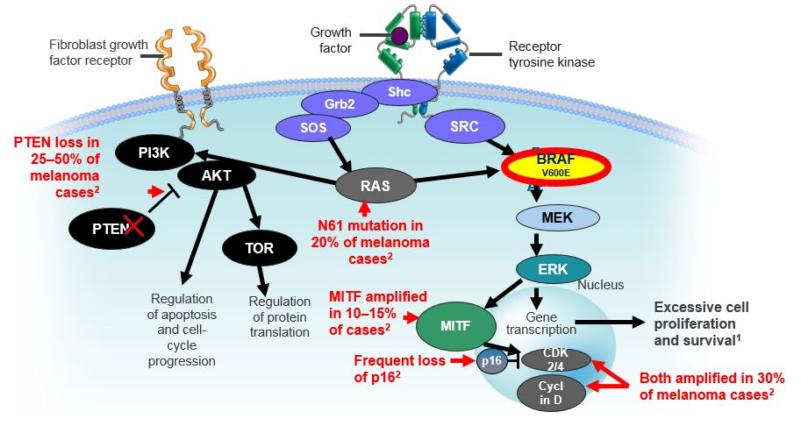
Molecular characterization
In melanoma and other types of cancer, the same pathways that are important for cell survival and function in healthy cells, such as the PI3K and MAPK pathways, instead drive cancer cell proliferation and survival
Alterations in the MAPK pathway can occur as a result of gene mutations, deletions, amplifications, or other factors
The red arrows indicate signaling components whose functions are commonly affected in melanoma

Slide 12
Molecular characterization
The BRAF^{V600} mutation occurs in approximately 40–60% of all cutaneous melanomas and leads to the constitutive activation of the BRAF kinase³
Over 90% of BRAF^{V600} mutations are type V600E. Less common types include V600K and V600G/R, which occur in approximately 5–6% and 3% of cases, respectively
Despite the known role of BRAF mutations in the development of melanoma, the role of BRAF as a prognostic marker remains unclear^{5,6}

Slide 13
Predictive and Prognostic Biomarkers
ECOG PS
lactate dehydrogenase (LDH) levels
The number of metastatic sites
offer predictive and prognostic value in patients undergoing targeted therapy
1.0
0.8
0.6
OS %
0.4
0.2
Normal LDH (N=32)
LDH > ULN (N=34)
0
0
5
10
15
20
Time in months

Slide 14
MANAGEMENT OF localized melanoma
Full depth, wide local excision (WLE) of primary tumors is recommended
Definitive radiotherapy (RT): considered in carefully selected patients for local control when excision is not possible either due to severe patient comorbidities (e.g. very old age, end-stage cardiovascular disease, etc.)
Wide local excision margins according to AJCC8 melanoma staging system (pT1a-pT4b Nx M0)
Tumor thickness (Breslow) in mm | Excision margin (cm)
Melanoma in situ (pTis N0 M0) | 0.5
<2 mm (pT1a-pT2 N0 M0) | 1
>2 mm (pT3a-pT4b N0 M0) | 2

Slide 15
Adjuvant Radiotherapy
adjuvant radiotherapy (RT) can no longer be routinely recommended.
Adjuvant RT should be considered for these patients on a case-by-case basis.
Associated with improved local control, particularly in patients with R1 margins or primary melanoma with Breslow thickness >4 mm, located in the head and neck region or desmoplastic neurotropic melanoma (DNM)
Benefit from adjuvant nodal basin RT selection based on location, size, number of positive nodes, and gross extranodal extension.
The current data regarding adjuvant RT, either WBRT or SRS, for resected brain metastases are insufficient to formulate a specific recommendation.

Slide 16
Treatment of locoregional melanoma
Primary tumor excision with adequate margins and CLND in patients with nodal metastases detected by SLNB and those with clinical evidence of regional disease.
For patients with a positive SLNB (not clinically), complete LN dissection (CLND) or irradiation of regional LNs should not be carried out.
Trials reported no impact on survival for early CLND compared with nodal observation with periodic US of the SLN-positive basin.
Factors that predict non-SLN positivity include mitotic rate, lymphovascular invasion, head/neck location, sentinel node tumor burden, number of positive nodes, and thickness/ulceration of the primary tumor

Slide 17
Adjuvant treatment
Stage 0 - IA - IB – IIA observation or clinical trials
Stage IIB-IIC disease adjuvant pembrolizumab¹ or nivolumab²
Currently, no overall survival (OS) data are available from the KEYNOTE-716 and CheckMate 76K trials.
Based on these findings, clinicians can offer adjuvant anti-PD-1 treatment for patients with AJCC8 stage IIB-IIC disease after a detailed discussion with the patient to weigh the pros and cons of treatment benefit versus toxicity and a careful evaluation of clinical factors, including patient age, comorbidities, performance status (PS), reproductive potential, personal/family history of autoimmune disease and compliance in case of immune-related toxicity.

Slide 18
Resectable stage III disease⁺
Resectable stage III disease:
Observation
Nivolumab¹
Pembrolizumab²
Dabrafenib/trametinib if BRAF V600E mutation positive ³
ResectableStage III clinically Positive nodes: neoadjuvant *
Pembrolizumab⁴
Nivolumab/ipilimumab⁵
(It is unclear which neoadjuvant regimen is more active since they have not been directly compared)

Slide 19
Resectable stage III disease
Neoadjuvant therapy may be particularly beneficial in the following clinical situations:
Patients with resectable stage III melanoma confined to the LNs, detectable by clinical or radiological assessment.
Patients with resectable ITMs or oligometastatic stage IV disease.
REFERENCES:
Weber J, Mandala M, Del Vecchio M, et al. Adjuvant nivolumab versus ipilimumab in resected stage III or IV melanoma. N Engl J Med. 2017;377(19):1824-1835.
Eggermont AMM, Kicinski M, Blank CU, et al. Five-year analysis of adjuvant pembrolizumab or placebo in stage III melanoma. NEJM Evid. 2022;1(11):EVIDoa2200214.
Long GV, Hauschild A, Santinami M, et al. Adjuvant dabrafenib plus trametinib in stage III BRAF-mutated melanoma. N Engl J Med.2017;377(19):1813-1823. (COMBI-AD trial)
Patel S, Othus M, Prieto V, et al. LBA6 Neoadjuvant versus adjuvant pembrolizumab for resected stage III-IV melanoma (SWOG S1801). Ann Oncol. 2022;33(suppl 7):S1408.
Blank CU, Lucas MW, Scolyer RA, et al. Neoadjuvant nivolumab andipilimumab in resectable stage III melanoma. N Engl J Med.2024;391(18):1696-1708.(NADINA)

Slide 20
Unresectable stage III and IV
Despite the improvements in OS with currently available systemic treatments (ICIs and targeted therapy), with resistance still a challenge.
First-line treatment decisions must take into consideration prior neoadjuvant and/or adjuvant therapy received, timing of recurrence on/after adjuvant therapy or naïve patient
All patients
Nivolumab/ipilimumab¹
Nivolumab and relatlimab²
Pembrolizumab³
Nivolumab⁴
BRAF +
Dabrafenib/trametinib ⁵
Vemurafenib/cobimetinib ⁶
Encorafenib/binimetinib⁷

Slide 21
Unresectable stage III and IV
Nivolumab / relatlimab can be offered as first-line treatment but EMA approval is only for patients with tumour cell PD-L1 expression <1%. FDA approval is regardless of PD-L1 expression.
References:
Wolchok JD, Chiarion-Sileni V, Gonzalez R, et al. Overall survival with combined nivolumab and ipilimumab in advanced melanoma. N Engl J Med 2017;377:1345-1356.(CHECKMATE 067) (945 - 714)
Tawbi HA, Schadendorf D, Lipson EJ, et al. Relatlimab and nivolumab versus nivolumab in untreated advanced melanoma. N Engl J Med 2022;386:24-34.(RELATIVITY 047)
Ribas A, Puzanov I, Dummer R, et al. Pembrolizumab versus investigatorchoice chemotherapy for ipilimumab-refractory melanoma (KEYNOTE-002): a randomised, controlled, phase 2 trial. Lancet Oncol 2015;16:908-918.
Weber JS, D'Angelo SP, Minor D, et al. Nivolumab versus chemotherapy in patients with advanced melanoma who progressed after anti-CTLA-4 treatment (CheckMate 037): a randomised, controlled, open-label, phase 3 trial. Lancet Oncol 2015;16:375-384
Long GV, Stroyakovskiy D, Gogas H, et al. Dabrafenib and trametinib versus dabrafenib and placebo for Val600 BRAF-mutant melanoma: a multicentre, double-blind, phase 3 randomised controlled trial. Lancet 2015;386:444-451.
Larkin J, Ascierto PA, Dreno B, et al. Combined vemurafenib and cobimetinib in BRAF-mutated melanoma. N Engl J Med 2014;371:1867-1876.
Dummer R, Ascierto PA, Gogas HJ, et al. Encorafenib plus binimetinib versus vemurafenib or encorafenib in patients with BRAF-mutant melanoma (COLUMBUS): a multicentre, open-label, randomised phase 3 trial. Lancet Oncol 2018;19:603-615.

Slide 22
An indirect comparison of the RELATIVITY-047 and CheckMate-067 trial
Overall survival and progression-free survival: no statistically significant differences in progression-free survival (PFS) or overall survival (OS).
Objective response rate: similar between the two groups after weighting, though CheckMate-067 showed a slightly higher complete response (CR) rate (22% vs. 19.7% in the indirect comparison)
Grade 3 or 4 adverse events: The incidence of severe (grade 3 or 4) adverse events was substantially lower with nivolumab plus relatlimab (23%) compared to nivolumab plus ipilimumab (61-62%).
Treatment discontinuation: due to adverse events was also significantly lower in the relatlimab arm (18% vs. 41%).
Adverse event categories: Relatlimab also showed lower rates of specific adverse events, particularly gastrointestinal and hepatic events, as noted in a comparison of TRAEs by category.
The lower toxicity of the nivolumab-relatlimab combination suggests it may be a more tolerable option for a broader range of patients, potentially allowing for more sustained therapy, which can impact long-term outcomes.

Slide 23
Treatment selection
phase III DREAMSEQ trial
phase II SECOMBIT trial
phase II EBIN trial
First-line nivolumab/ipilimumab is the preferred treatment when a rapid response is not required due to aggressive/symptomatic disease, with targeted therapies reserved for subsequent treatment lines.
The optimal duration of induction targeted therapy and the best targeted therapy combination is currently unknown.
Atkins MB, Lee SJ, Chmielowski B, et al. Combination dabrafenib and trametinib versus combination nivolumab and ipilimumab for patients with advanced BRAF-mutant melanoma: the DREAMseq trial-ECOGACRIN EA6134. J Clin Oncol. 2023;41(2):186-197. (265)
Ascierto PA, Mandalà M, Ferrucci PF, et al. Sequencing of ipilimumab plus nivolumab and encorafenib plus binimetinib for untreated BRAFmutated metastatic melanoma (SECOMBIT): a randomized, three-arm, open-label phase II trial. J Clin Oncol. 2023;41(2):212-221. (69)
Robert C, Dutriaux C, Oppong FB, et al. Combination of encorafenib and binimetinib followed by ipilimumab and nivolumab versus ipilimumab and nivolumab in patients with advanced BRAF-V600E/Kmutated melanoma: the primary analysis of an EORTC randomized phase II study (EBIN). J Clin Oncol. 2024;42(suppl 17):LBA9503. (271)

Slide 24
Second-line treatment /stage IV
Treatment options for the second-line setting depend on the therapy used in the first line
Only pembrolizumab ,ipilimumab monotherapy and Lifileucel are EMA or FDA approved for second-line use.
imatinib, dasatinib (activating mutations of KIT)
Tumor-infiltrating lymphocyte therapy (TIL) Lifileucel
Larotrectinib, entrectinib (NTRK fusions)
Crizotinib, entrectinib (ROS1 fusions)
Trametinib (BRAF non-V600 mutation)
Binimetinib (NRAS-mutated tumors) (for progression following ICI therapy)
Combination BRAF/MEK + PD(L)-1 checkpoint inhibitors (eg, dabrafenib/trametinib + pembrolizumab or vemurafenib/cobimetinib + atezolizumabx if BRAF V600 mutation positive)
Cytotoxic agents: dacarbazine, temozolomide, paclitaxel, albumin-bound paclitaxel, carboplatin/paclitaxel, and cisplatin/vinblastine/dacarbazine (CVD)

Slide 25
Melanoma Brain Metastases
Patients with symptomatic MBMs have a poorer outcome.
neurosurgery, stereotactic radiosurgery (SRS), targeted therapy with a BRAF inhibitor (BRAFi)–MEK inhibitor (MEKi) combination and immunotherapies.
Patients with asymptomatic MBMs should preferably be treated upfront with nivolumab/ipilimumab
brain radiotherapy (WBRT) should be avoided whenever possible due to its lack of evidence for efficacy.
There are currently no systemic treatment options specifically approved for use in treating MBMs.
Standard chemotherapy agents (temozolamide and fotemustine ) have proved to have limited activity in brain metastases; presumably due to their limited ability or inability to cross the BBB

Slide 26
THANK YOU

